Slide 1
HS Corpus Linguistics / Korpuslinguistik 3. Statistical analysis of frequency data
Prof. Dr. Stephanie Evert Chair of Computational Corpus Linguistics FAU Erlangen-Nürnberg

Slide 2
Outline
Quantitative analysis of corpus data: Why do we need statistics?
Keywords
an application of frequency comparison methods
the need for empirical evaluation studies
Collocations
bonus: lexicographic evaluation of corpus-based collocation identification

Slide 3
Interpreting corpus frequencies
Interpret as relative frequency (e.g. per million words)
But need absolute frequency counts to assess statistical significance!

Slide 4
Example: déjà vu
Spellings of déjà vu in the BNC
38x with accents déjà vu
23x without deja vu
3x confused déjá vu etc. (we'll ignore these here)
Can we say that the correct spelling is most common in BrE (i.e. has relative frequency π > 50%)?
Direct estimate:
NB: not frequency per million words in this case!

Slide 5
Sampling variation
But what if the compilers of the BNC had chosen a slightly different set of texts? Would we still find the same proportion of déjà vu?
Random sample ➞ sampling variation
Statistical hypothesis tests can be used to assess how much sampling variation has to be expected
A “what if” game starting from null hypothesis H₀: H₀: π = 50%
Simulate many random samples of same size n = 61
drawn from a population in which H₀ is true

Slide 6
Binomial sampling variation
p-value = 7.2% specifies risk that observation is a coincidence (if H₀ is true).
Only results with p-value < 5% (or even lower) are considered to be statistically significant.
➞ binomial hypothesis test for observation k = 38 / n = 61

Slide 7
Confidence intervals & effect size
What about –ize vs. –ise?
1398x characterise
1278x characterize
Binomial test for 1398 / 2676: p-value = 0.02* (= 2%)
input: “successes” k / sample size n
try it for yourself: http://sigil.collocations.de/wizard.html
significance is achieved because of large sample size
Confidence interval for π = all H₀ that cannot be rejected (with p < .05 or other significance level)
Indicates small effect size: 50.3% ≤ π ≤ 54.2%

Slide 8
Frequency estimates
Confidence intervals should always be computed for corpus frequencies!
E.g. kick the bucket in BNC
16 hits for CEQL query {kick/V} <<3>> {bucket/N}
corresponds to p = 0.16 pmw
confidence interval for 16 / 98313429: 0.085 pmw ≤ π ≤ 0.252 pmw
footnote: is this really the usage frequency of the idiom?
Not supported by standard corpus tools yet
but we're working on it
various statistical problems (e.g. non-randomness)
sample size = number of tokens

Slide 9
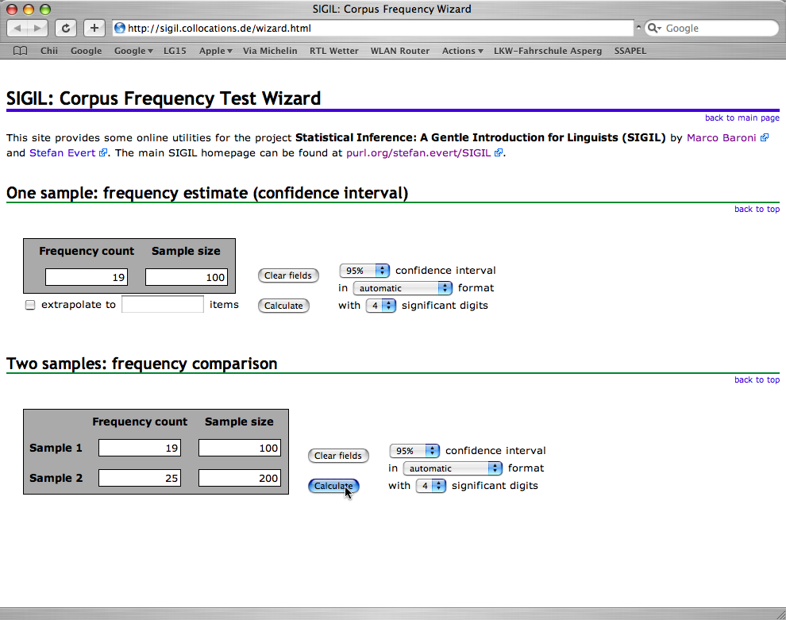
Hypothesis tests in practice
http://sigil.collocations.de/wizard.html
http://corpora.lancs.ac.uk/sigtest/
http://vassarstats.net/
SPSS, SAS, Excel, …
best to use dedicated software:

Slide 10
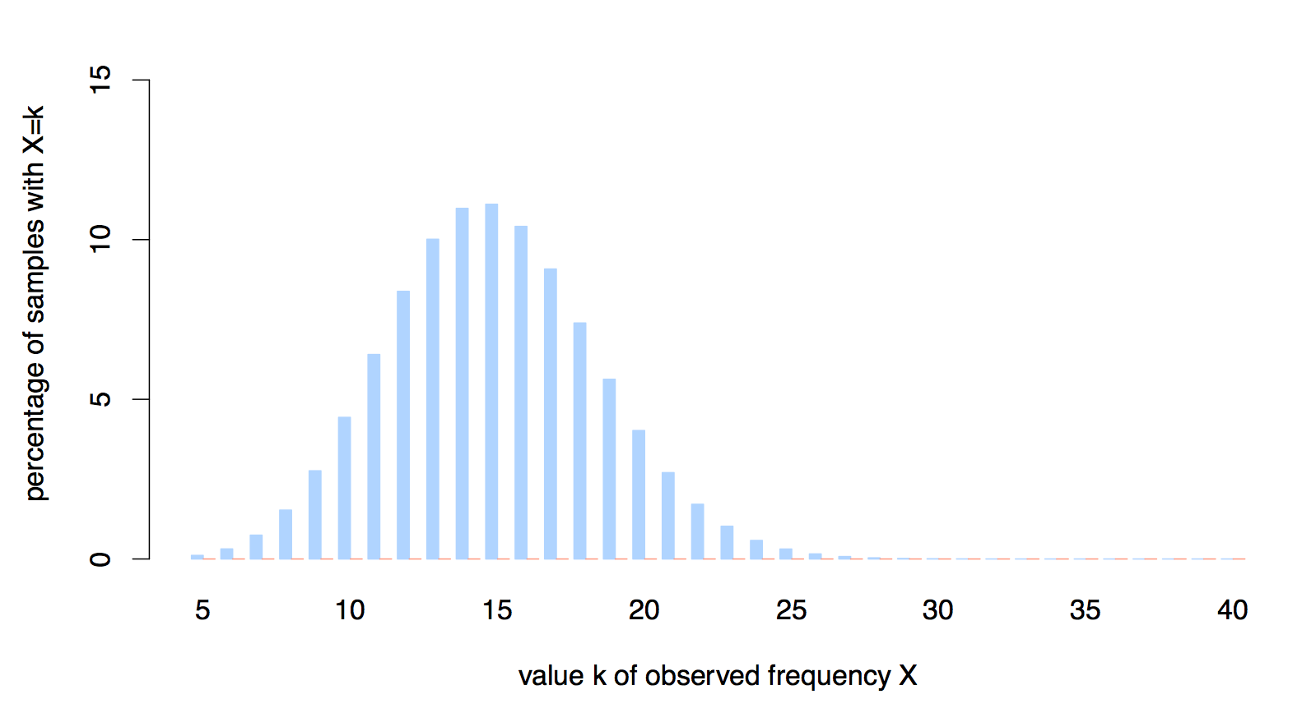
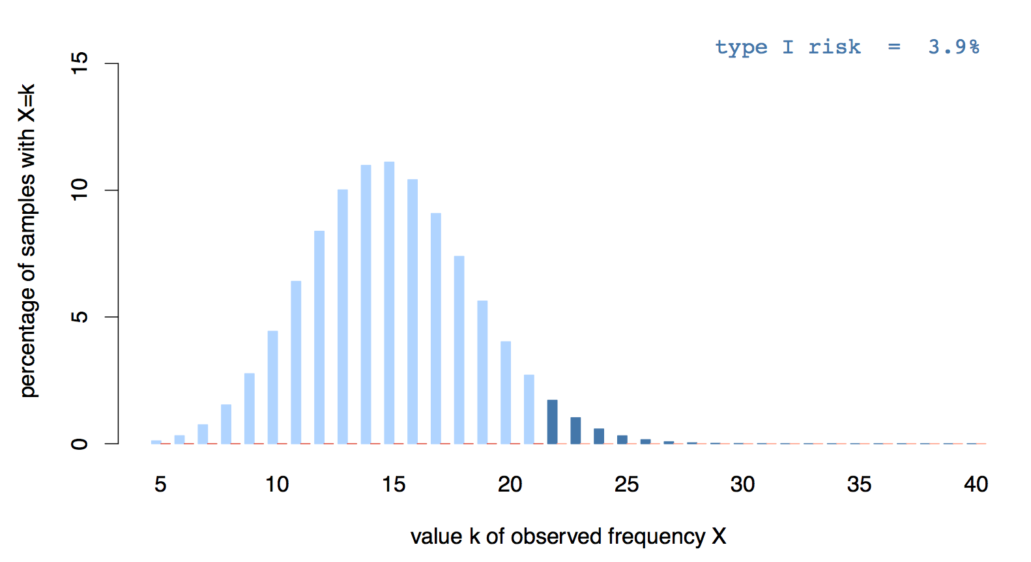
Type I errors
binomial sampling distribution under H0: π=.15
rejection by one-sided binomial test (p < .05*)
Notes:
• Use one-sided binomial test for clarity of exposition
• Rejection criterion at significance level α = .05 is k ≥ 22

Slide 11
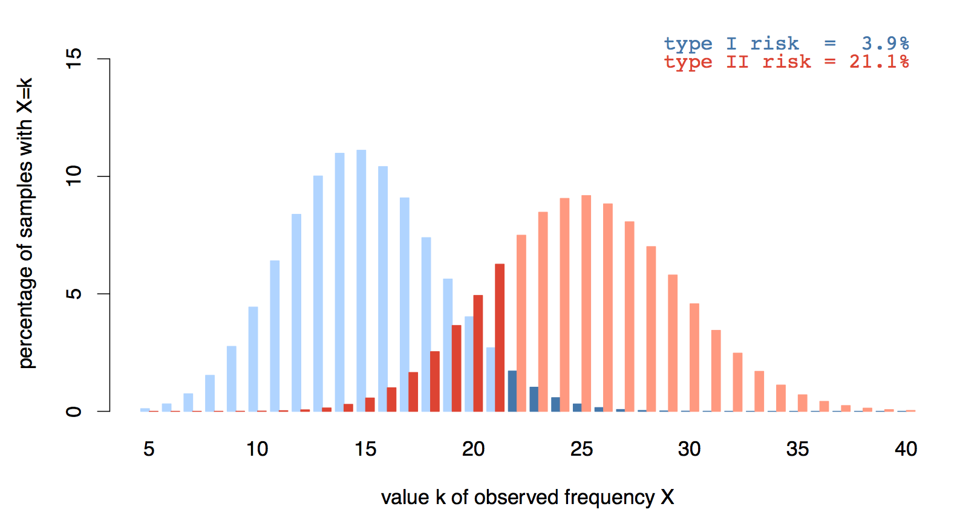
Type II errors
type II risk for k ≤ 21 = 21.1%
binomial sampling distribution under H0: π=.15
sampling distribution for hypothetical π=.25
Notes:
• In order to determine the true sampling distribution and estimate the risk of a type II error, need to make assumption about true proportion, e.g. π = .25
• With rejection criterion k ≥ 22, we commit a type II error for every sample with k ≤ 21 (for situation where H0 is not true)
• Risk of type II error = left tail probability
• Type II risk >> type I risk (because hypothesis tests are conservative wrt. type I errors)

Slide 12

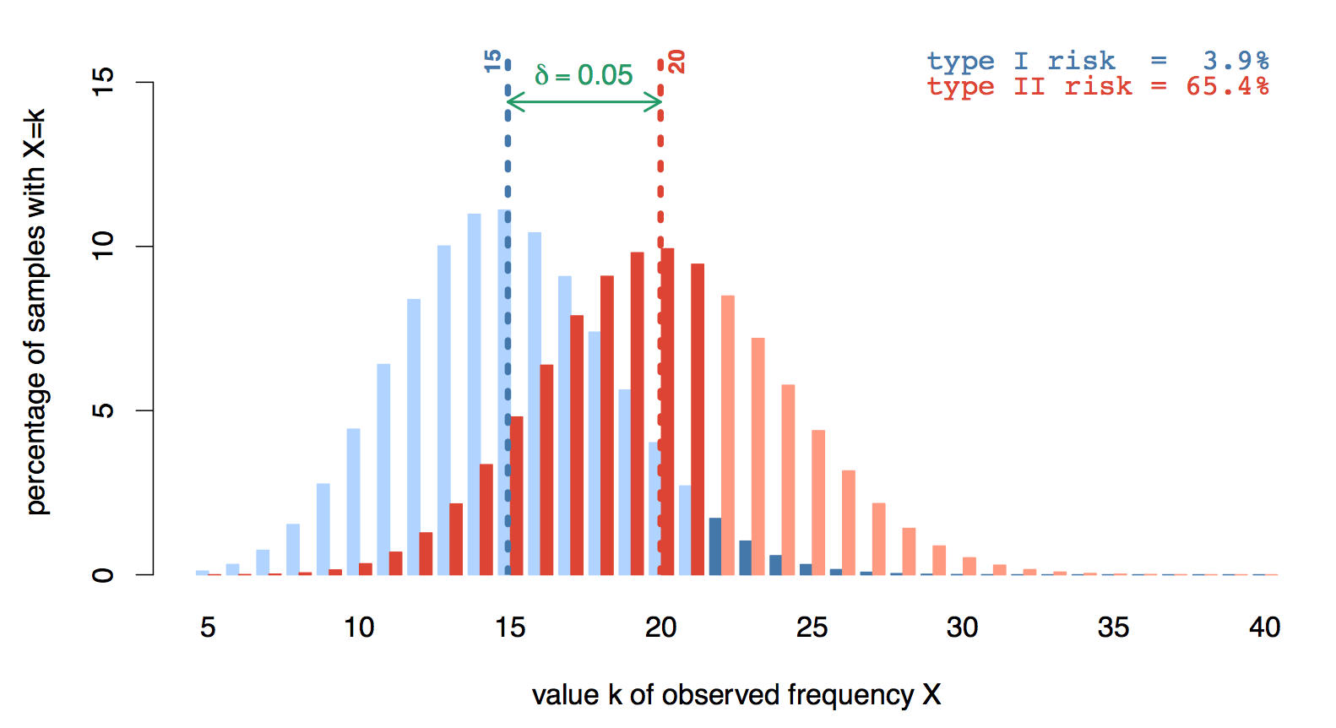
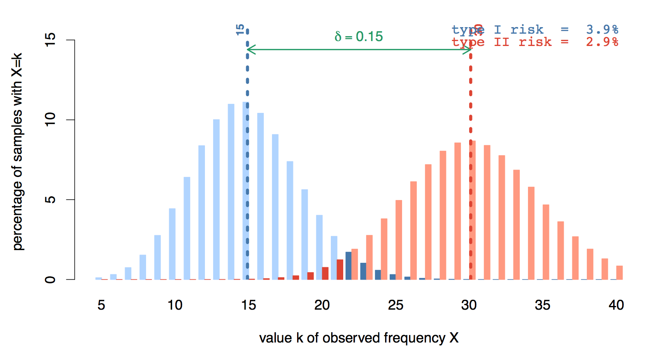
Type II errors & effect size
effect size δ
Notes:
• Here: considerable type II risk despite large effect size of 10% points
• Because of sampling variation, many samples will have fewer than the expected k = 25 passives, and some even k ≤ 21
• Type II risk depends crucially on effect size

Slide 13
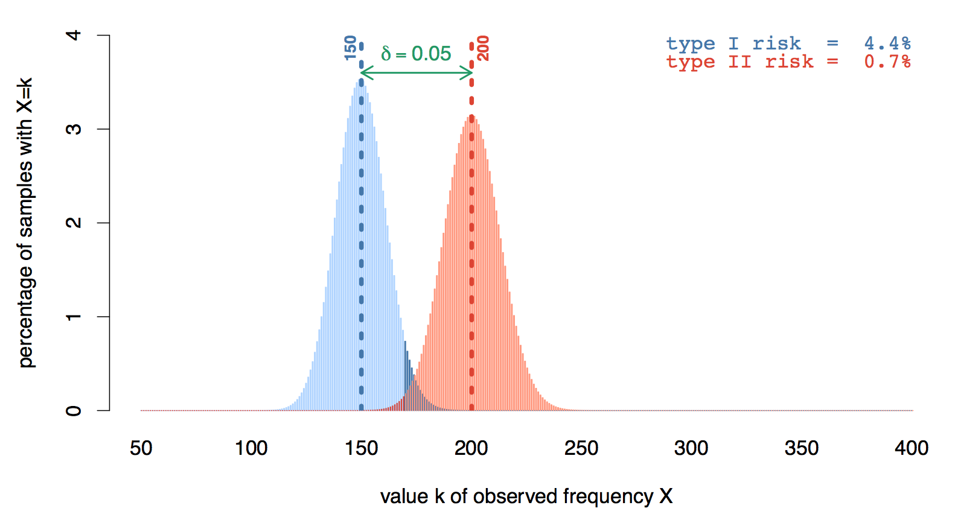
Type II errors & sample size
n = 100
n = 1000

Slide 14
Confidence interval
observed data:
k = 190 / n = 1000
95% confidence two-sided p < .05 = α
16.6% … 21.6%
Notes:
• Q: Why do we want to use a two-sided test here?

Slide 15
Confidence intervals
Confidence interval = range of plausible values for true population proportion
H0 rejected by test iff π0 is outside confidence interval
Size of confidence interval depends on power of the test (i.e. sample size and significance level)
Notes:
• Not the full truth: confidence set for exact two-sided test need not be a contiguous interval; but this is an advanced mathematical problem and most software approximates intervals
• Confidence intervals also help us to interpret test results properly: can we just reject H0, or are we also confident that the true proportion is SUBSTANTIALLY higher than 15%?
• Note that H0 cannot be rejected if it falls within the confidence interval (for n=100)
• For n=1,000 we have a clear difference from H0 at 95% confidence, but at 99.9% confidence there is only a marginal rejection: true proportion MIGHT be as low as 15.1%
• For n=10,000 there is a substantial difference from H0 at all confidence levels: the true proportion of passives must be at least ca. 18%
• CLICK, then remember framed values – we'll see how to compute this confidence interval in R

Slide 16
Frequency comparison
Similar principles can be used to compare frequencies in different corpora / sub-corpora
Application to lexical frequencies: keyword analysis
Data for frequency comparison test:
f₁ = frequency in corpus 1 n₁ = sample size of corpus 1
f₂ = frequency in corpus 2 n₂ = sample size of corpus 2
Collected in contingency table = cross-classification
corpus 1
corpus 2
f₁ | f₂
n₁ – f₁ | n₂ – f₂

Slide 17
Frequency comparison
Null hypothesis H₀: π₁ = π₂
precise value of common relative frequency not specified
Different significance testing procedures:
Pearson's chi-squared test ➞ X² statistic (↑)
likelihood ratio test (“log-likelihood”) ➞ G² statistic (↑)
Fisher's exact test ➞ p-value (↓)
Different ways of measuring effect size
difference of proportions: δ = π₁ – π₂
relative risk = proportion ratio: r = π₁ / π₂
odds ratio (nice for maths): θ = π₁(1 – π₂) / π₂(1 – π₁)

Slide 18
The broader picture on statistics in corpus linguistics
representative random sample
population
(of “objects”)
Statistics (hypothesis tests)
corpus data
(frequencies)
operationalized
hypothesis
about “language”
linguistic research question
Notes:
Recall the first steps / design of a corpus study
Conclusion: corpus should be a representative sample of the “language” to be studied in the sense of a statistical random sample

Slide 19
Further reading
Ch. 5 of Hoffmann, Sebastian et al. (2008). Corpus Linguistics with BNCweb – a Practical Guide. Peter Lang, Frankfurt.
Baroni, Marco and Evert, Stefan (2008). Statistical methods for corpus exploitation. In HSK 29.2 Corpus Linguistics, Ch. 36.
Evert, Stefan (2013). Tools for the acquisition of lexical combinatorics. In HSK 5.4 Computational Lexicography, Ch. 104.
Evert, Stefan (2008). Corpora and collocations. In HSK 29.2 Corpus Linguistics, Ch. 58.
Hardie, Andrew (unpubl.). A single statistical technique for keywords, lockwords, and collocations. Technical report.
… and many recent textbooks on statistical methods for (corpus) linguistics by Stefan Gries, Guillaume Desagulier, Bodo Winter, Vaclav Brezina, Sean Wallis, Gerold Schneider & Max Lauber.
https://dlf.uzh.ch/openbooks/statisticsforlinguists/

Slide 20
Keywords
An evaluation study

Slide 21
Keyword extraction techniques
f₁ | f₂
n₁ – f₁ | n₂ – f₂
Textbook approach: G² log-likelihood significance test (Dunning 1993)
Effect size measure: LR log ratio f₁/n₁ : f₂/n₂ (Hardie unpulished)
combined with Bonferroni-corrected significance filter
Statistician's choice: LR_{cons} conservative LR (Evert 2022)
lower bound of confidence interval (Hardie's formula)
with Bonferroni correction
f₁ = freq. in target corpus
n₁ = sample size of target
f₂ = freq. in reference corpus
n₂ = sample size of reference

Slide 22
Keyword extraction techniques
f₁ | f₂
n₁ – f₁ | n₂ – f₂
Methodological discussion: non-randomness / term clustering as key issue
Simple correction: use document frequency (df) instead of raw frequency
Mathematical justification as statistical inference for α parameter of Katz (1996)
f₁ = df in target corpus
n₁ = #texts in target corpus
f₂ = df in reference corpus
n₂ = #texts in reference

Slide 23
Corpus
14.3M token corpus on German web data about multi-resistant pathogens (MRO) collected with BootCat (Baroni & Bernardini 2004)
9,750 texts of varying genres and lengths
Annotated manually with metadata!
Target subcorpus: 1.3M tokens (1,177 texts) of mass media texts and reader comments
Actor – author: media
Actor – reader: general public
Topic: MRO

Slide 24
Reference corpora
Years 2011–2014 of Süddeutsche Zeitung (SZ), a left-leaning daily newspaper (290M tokens)
Years 2011–2014 of Frankfurter Allgemeine Zeitung (FAZ), a right-leaning daily newspaper (150M tokens)
All corpora: POS-tagged with TreeTagger and lemmatised with SMOR (Schmid et al. 2004)

Slide 25
Experiments
Extract top-200 keywords for each technique
frequency threshold f ≥ 5 in reference corpus, because we are not interested in terminology extraction
Manual annotation of TPs (categories, evaluative)
Two comparable newspaper reference corpora: Süddeutsche (SZ) vs. Frankfurter Allgemeine (FAZ)
Keywords based on raw frequency (classic) vs. document frequency (df-based)

Slide 26
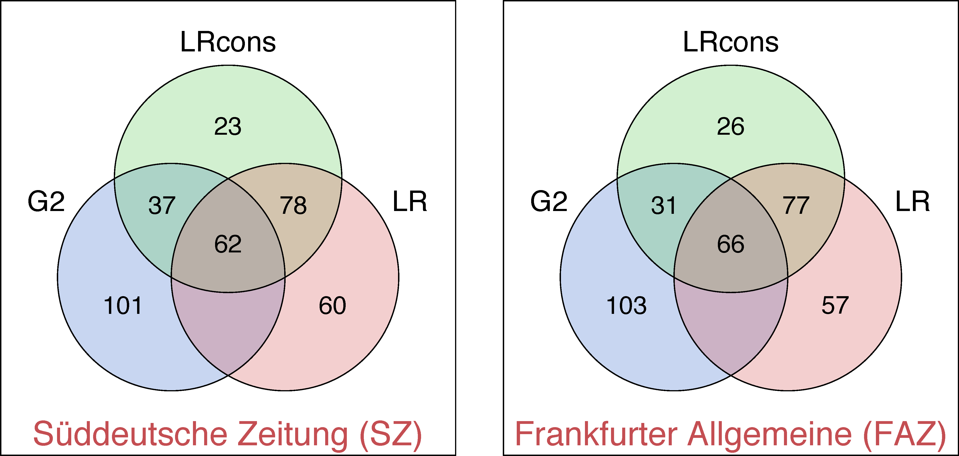
Overlap between techniques

Slide 27
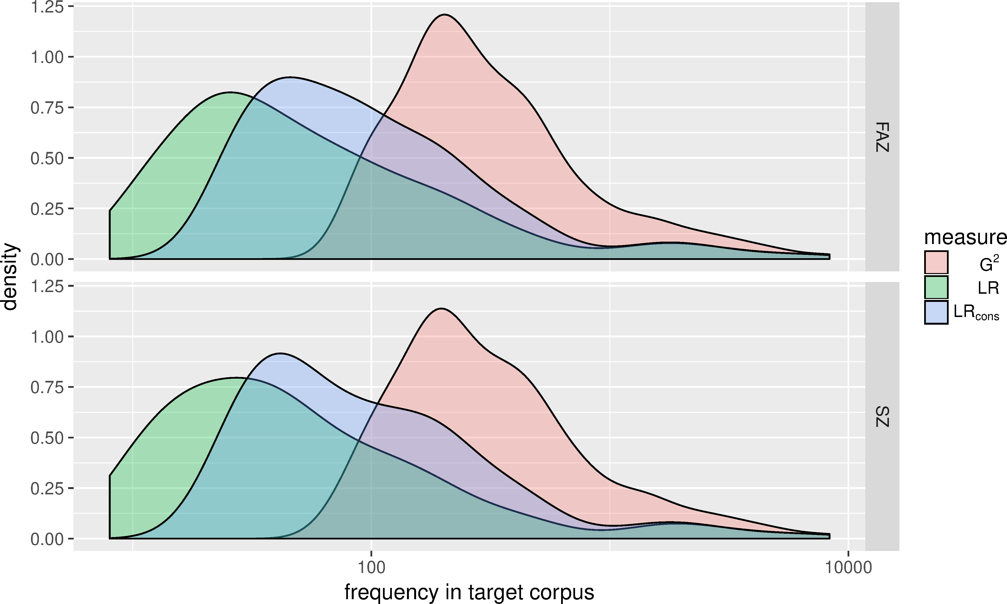
Frequency bias

Slide 28
Manual annotation
Annotation of top 200 lexical KW for different techniques following gold standard based on previous analysis of a different MRO press corpus (Peters 2017)
Adaption of selected aspects of the DIMEAN model (Spitzmüller/Warnke 2011)
Actor
Topos
Metaphor
False positives (unclear/other/irrelevant)
Additional category: evaluative lexis (positive/negative stance)

Slide 29
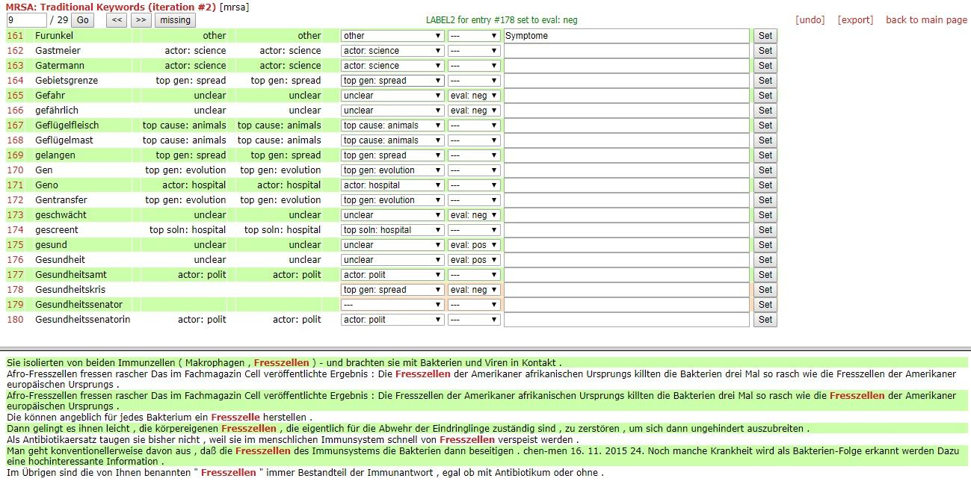
Manual annotation
Web-based annotation platform MiniMarker

Slide 30
Agreement
Two independent annotators
Agreement of 82.2% on distinction TP vs. FP (but Cohen κ = .566 fairly low)
Domain-specific, highly frequent words often marked FP (“unclear”) by one annotator and TP by the other
Disagreements between TP categories less frequent; mostly due to overlap between discourse levels
metaphors as part of topoi
intertwined argumentational levels
Final gold standard jointly reconciled by annotators

Slide 31
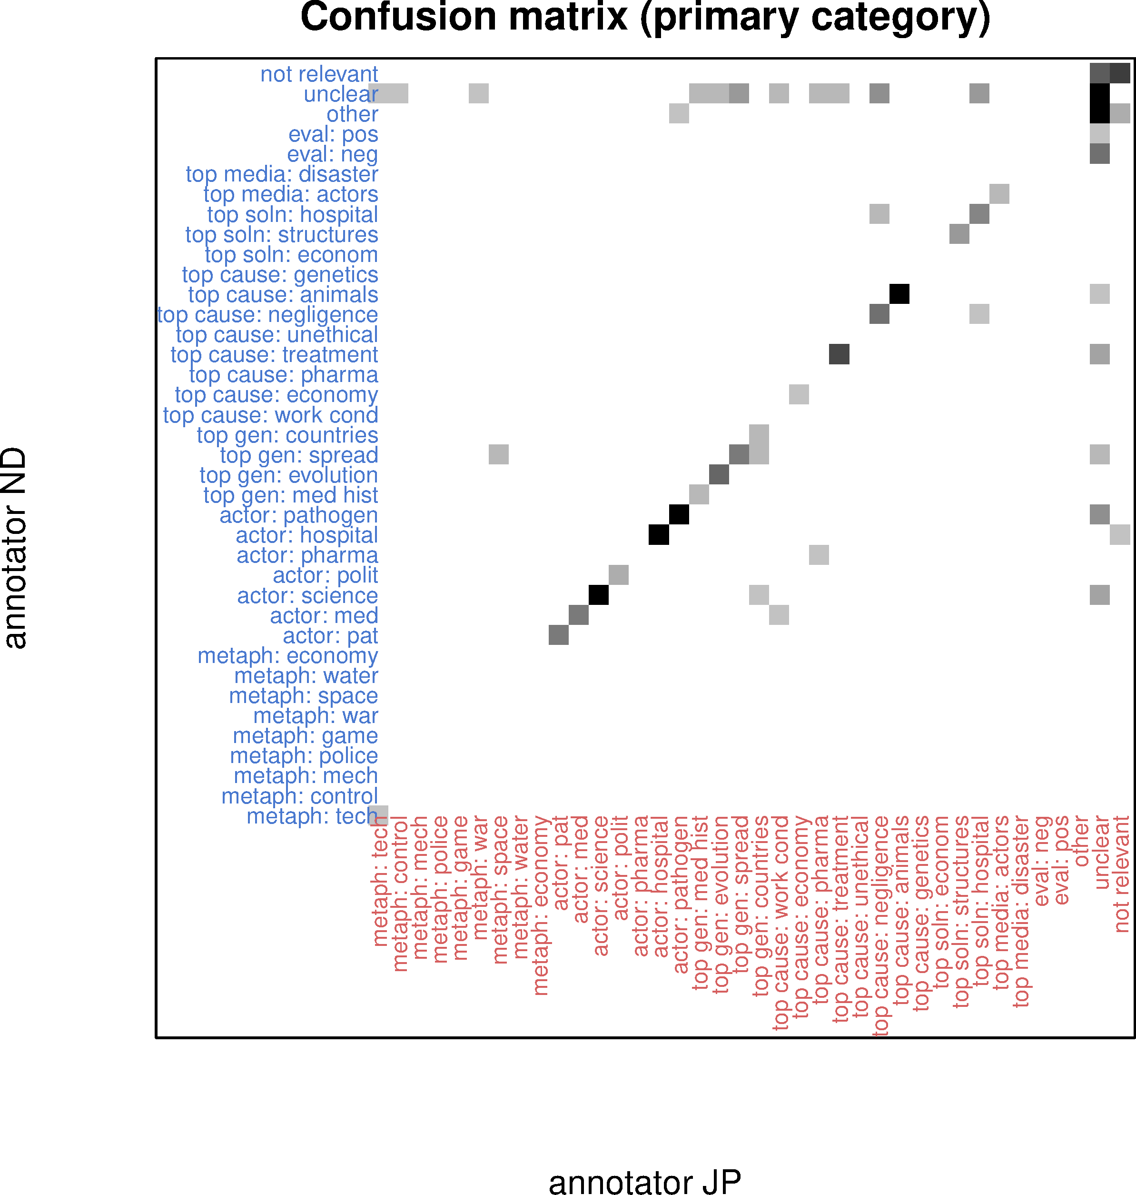
IAA

Slide 32
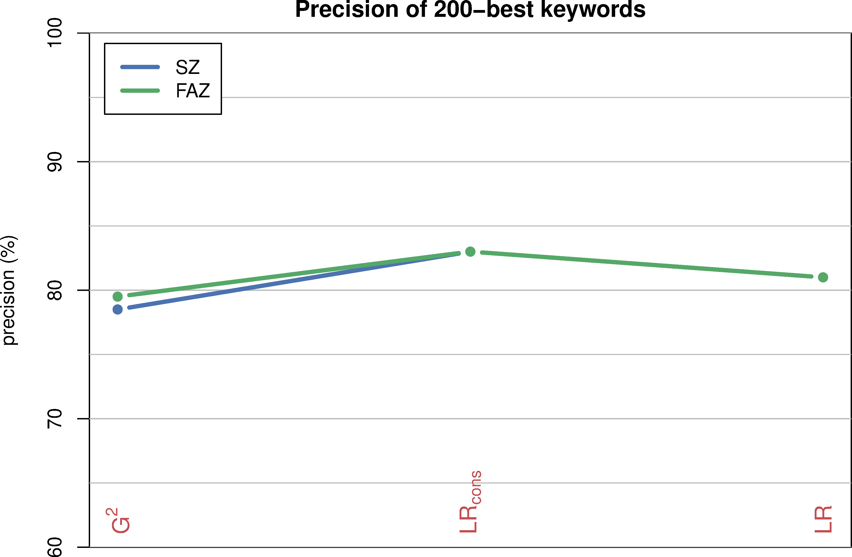
Precision = #TP / 200 cand.
TP = assigned to category and/or evaluative

Slide 33
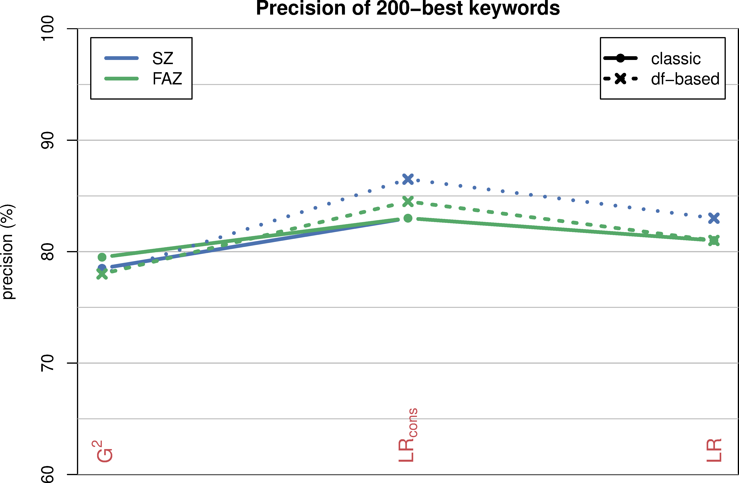
Precision = #TP / 200 cand.
TP = assigned to category and/or evaluative
*

Slide 34
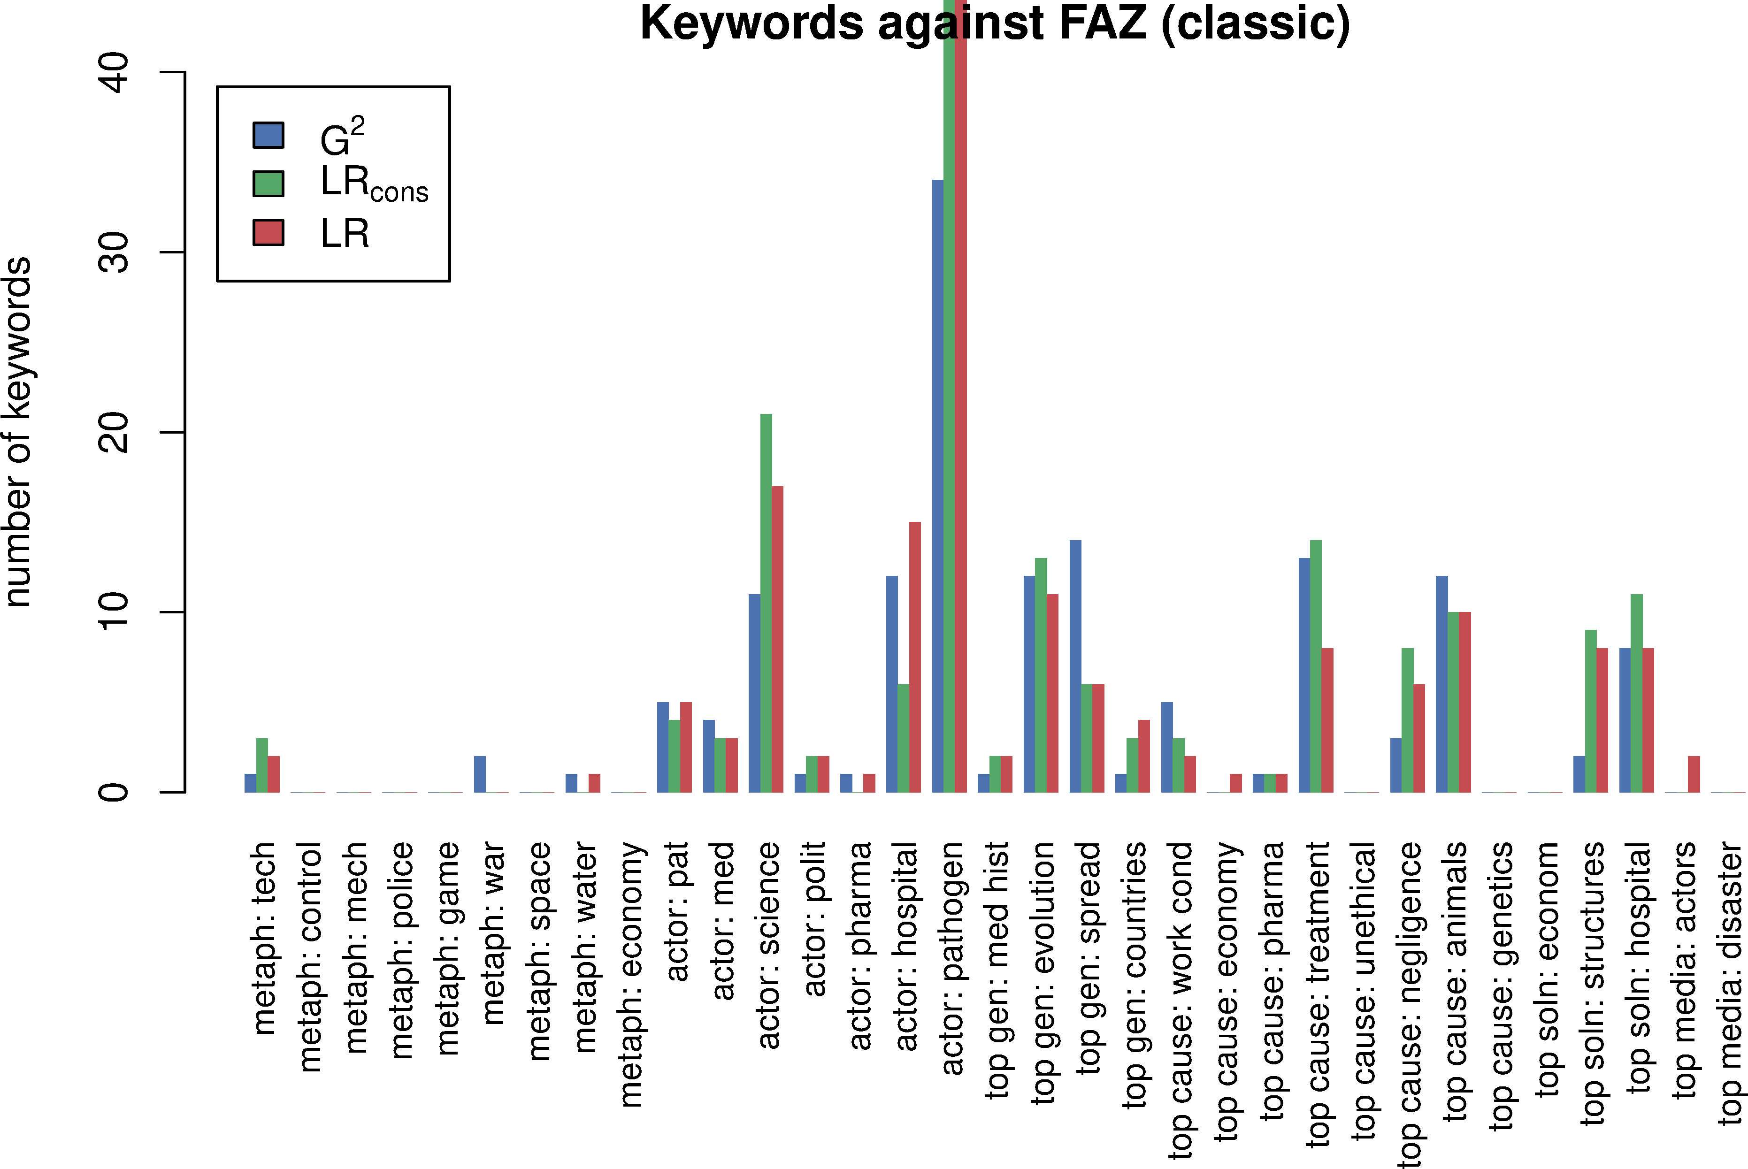
Recall = #kw for each category

Slide 35
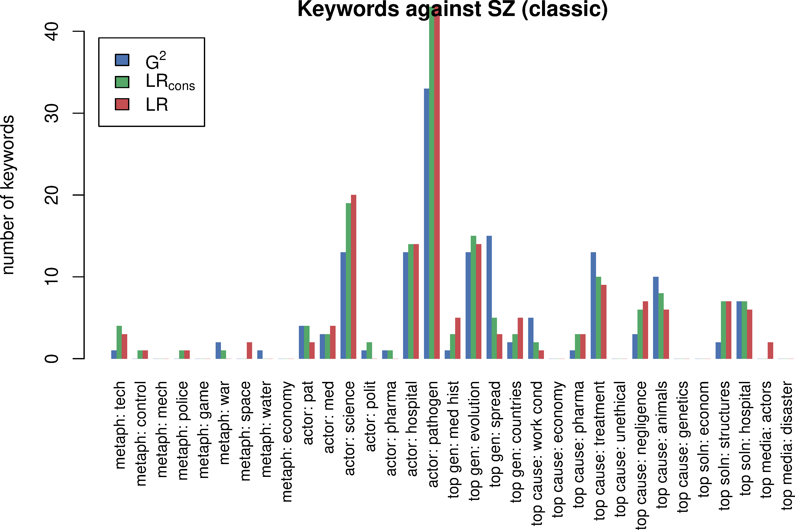
Recall = #kw for each category

Slide 36
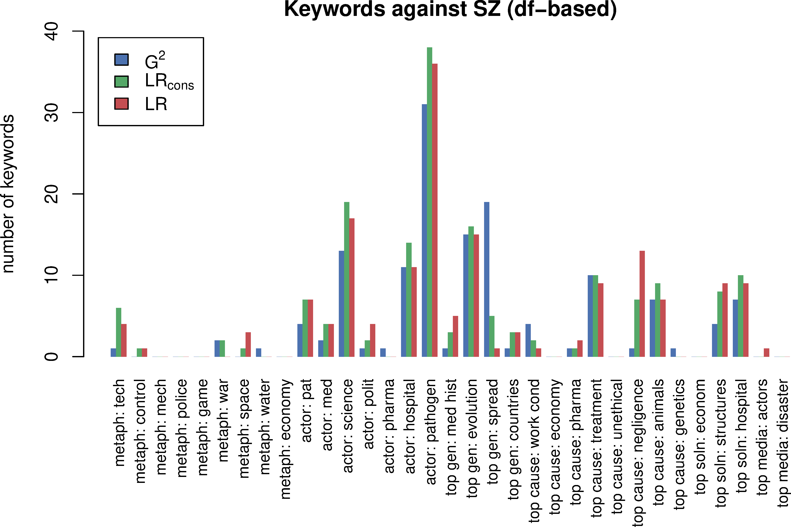
Recall = #kw for each category

Slide 37
Collocations
An evaluation study

Slide 38
Collocations
Corpus linguistics: collocations as (statistically) salient co-occurrence patterns of words
most common perspective: single-word collocates of a “node” word or phrase, ranked by statistical salience
evidence for lexicalised multiword expressions (MWE)
typical usage patterns (➞ discourse analysis, CALL, …)
indicative of word meaning and different word senses (in NLP: “one sense per collocation”)
widely used in computational lexicography
Different types of co-occurrence: surface span, textual unit, syntactic relation (Evert 2008)

Slide 39
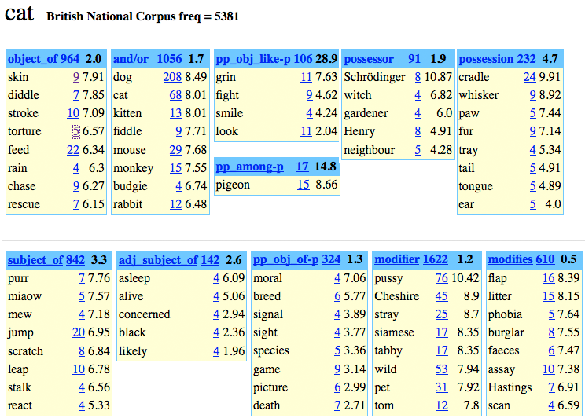
Word sketch = syntactic co-occurrence
adjective-noun (pre-nominal modifier)

Slide 40

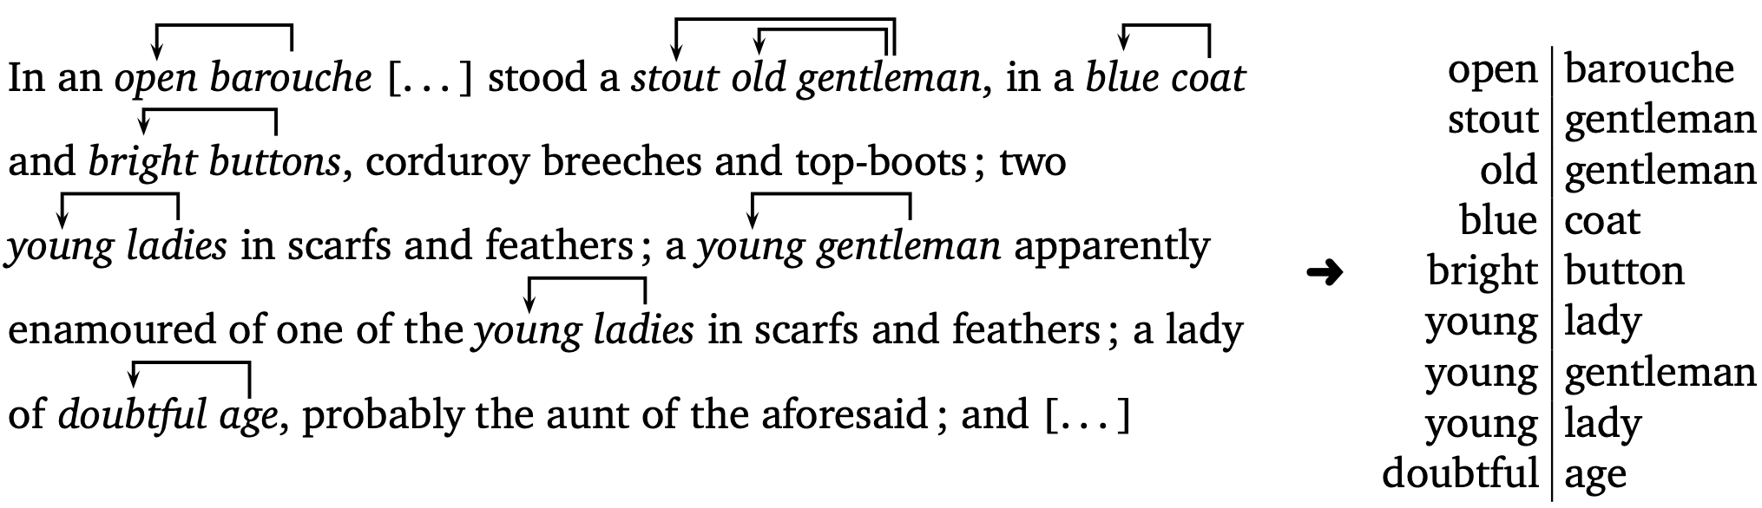
Syntactic co-occurrence
 | •|gent. | •|¬gent
young|•
¬young|•
f(young, gentleman)

Slide 41
Syntactic co-occurrence
 | •|gent. | •|¬gent
young|• | 1 | 2 | 3
¬young|• | 2 | 4 | 6
 | 3 | 6 | 9
 | •|gent. | •|¬gent
young|•
¬young|•
 |  |  | 9
f(young, gentleman) = 1
sample size N = 9

Slide 42

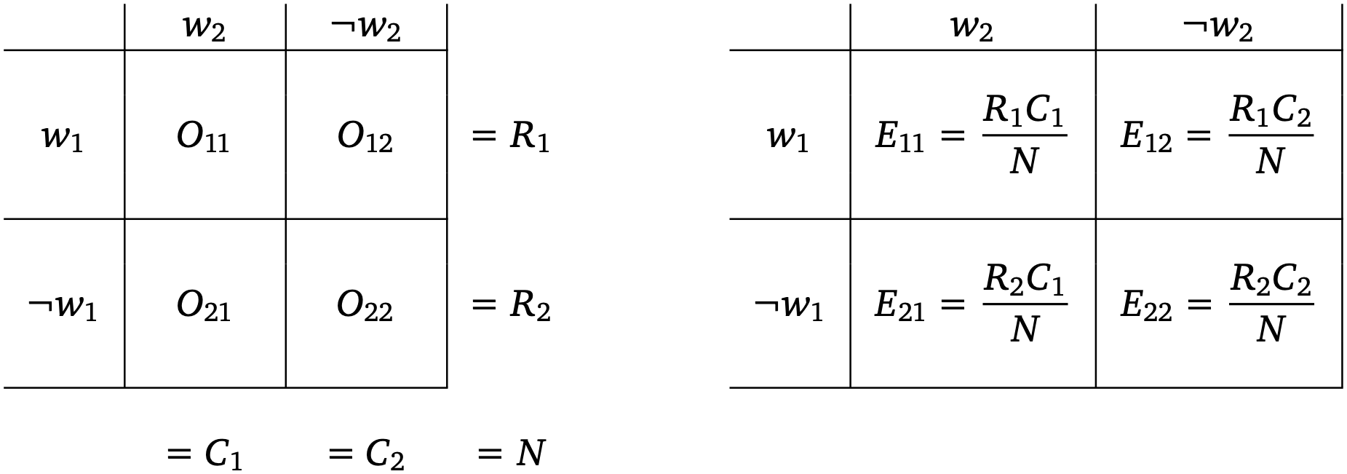


Statistical association measures (AM)
H₀: statistical independence
π_{cooc} = π₁ × π₂
observed
expected

Slide 43
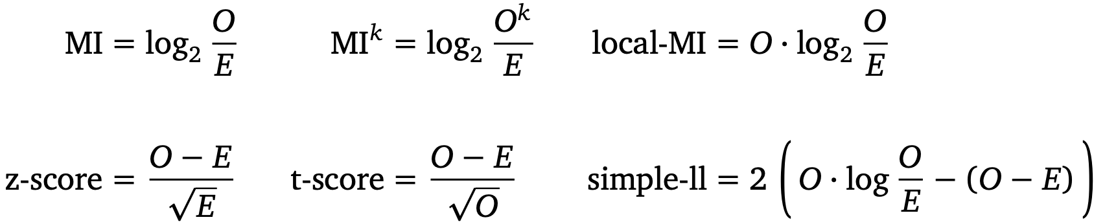


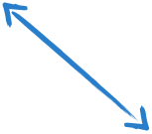
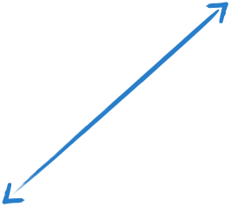
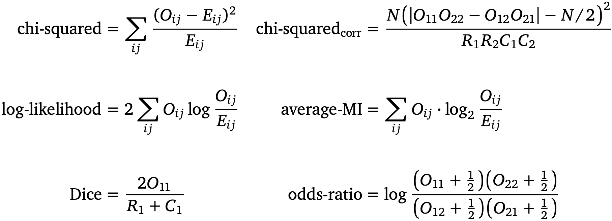


Statistical association measures (AM)
recommended measures (Evert 2008)
Sketch Engine™
Notes:
• Some simple measures are also nearly equivalent to each other (but note that z-score and t-score are completely different measures)
• Connections between simple measures and statistical measures because of mathematical derivation (simple AM is often approximation to “correct” statistical AM)
• Recommended measures (Evert 2008) give four different perspectives on 1st-order statistical association
• We'll get back to the selection of an appropriate AM later on!
• Sketch Engine™ claims to implement scaled version of the Dice coefficient (according to online documentation); up to September 2006, a nonstandard heuristic variant of MI was used

Slide 44
Evaluating collocation identification (Evert et al. 2017)
Many parameters for collocation extraction, but which settings are most suitable?
Here: broad-scale comparative evaluation
Which AM correlates best with collocativity?
What is an appropriate co-occurrence context?
Which source corpora provide the best results?
Does size matter? Or representativeness?
Are there interactions between these parameters?
Are crawled Web corpora and n-gram databases a viable substitute for expensive reference corpora?

Slide 45
Gold standard
BBI: The BBI Combinatory Dictionary of English (Benson, Benson & Ilson 1986)
based on lexicographic native-speaker intuitions
pre-corpus era ➞ no bias towards specific method/corpus
OCD2: Oxford Collocations Dictionary for students of English, 2nd ed. (McIntosh, Francis & Poole 2009)
corpus-based, much more comprehensive
clearer notion of collocation (≈ our subtypes of MWE)

Slide 46
The Bartsch224 gold standard
Set of 203 node words selected by Sabine Bartsch
original set contained approx. 224 node words
some obscure nodes with few collocates omitted
Manually extracted all lexical words (nouns, verbs, adjectives, adverbs) from corresponding BBI entries
set of 2,845 node-collocate pairs
lemmatized, reduced to two-word collocations
Automatic extraction from XML version of OCD2
also from other entries (our node word listed as collocate)
set of 18,545 node-collocate pairs

Slide 47
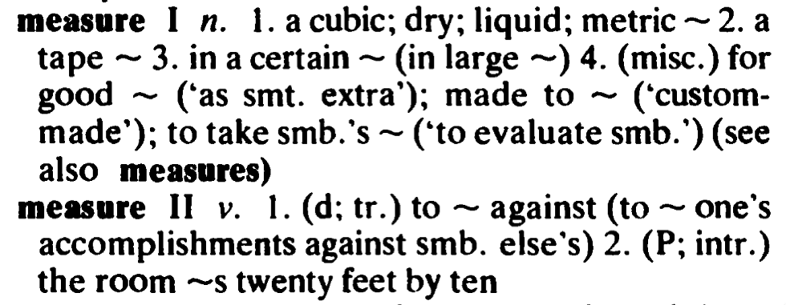
Gold standard example: BBI
Node: measure (noun or verb)
👉 cubic, dry, liquid, metric, tape, certain, good, make, take,

Slide 48
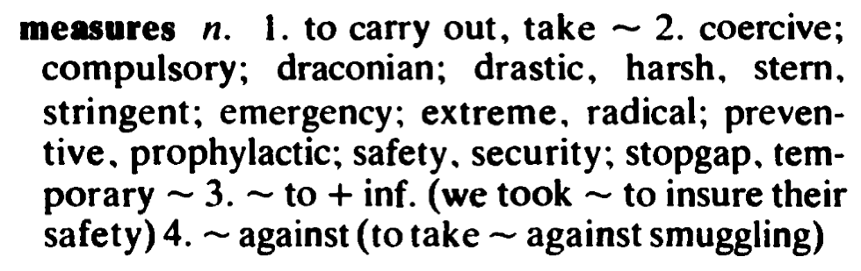
Gold standard example: BBI
Node: measure (noun or verb)
👉 cubic, dry, liquid, metric, tape, certain, good, make, take,
carry, coercive, compulsory, draconian, drastic, harsh, stern, stringent, emergency, extreme, radical, preventive, prophylactic, safety, security, stopgap, temporary

Slide 49
Gold standard example: OCD
Node: measure (noun or verb)
👉 cubic, dry, liquid, metric, tape, certain, good, make, take,
carry, coercive, compulsory, draconian, drastic, harsh, stern, stringent, emergency, extreme, radical, preventive, prophylactic, safety, security, stopgap, temporary
👉 ability, able, accurate, accurately, achievement, activity, additional, adopt, aim, angle, appropriate, approve, austerity, autonomy, ballot, brandy, broad, calculate, carefully, change, circumference, composition, conservation, considerable, control, corrective, cost-cutting, crude, cup, defeat, defensive, density, derive, and 158 more

Slide 50
Parameters: association measure
Mutual Information (MI, Church & Hanks 1990)
t-score (t, Church et al. 1991)
MI², MI³, MI⁴ (Daille 1994) + MI_{conf} (Johnson 2001)
chi-squared (X²) and z-score (z) with Yates correction
Dice (SketchEngine), Jaccard coefficient
minimum sensitivity (MS, Pedersen & Bruce 1996)
odds ratio (log θ, log θ_{disc}), relative risk (log r)
log-likelihood (G², Dunning 1993)
ΔP (Gries 2013) in 4 variants (fwd, bwd, min, max)
co-occurrence frequency (f)

Slide 51
Parameters: co-occurrence context
syntactic co-occurrence: dependency relations
direct dependency (all types, both directions)
surface co-occurrence: L1 / R1
surface co-occurrence: L2 / R2
surface co-occurrence: L3 / R3
surface co-occurrence : L5 / R5
surface co-occurrence : L10 / R10
textual co-occurrence: sentence

Slide 52
Parameters: corpus & annotation
corpus | annotation | size
British National Corpus (BNC, Aston & Burnard 1998) | C&C, Stanford | 0.1 G
Darmstadt English Movie Subtitle Corpus (DESC) | C&C, Stanford | 0.1 G
Gigaword newspaper corpus (2nd ed.) | C&C, Stanford | 2.0 G
English wikipedia of 2009 (Wackypedia) | C&C, Malt, Stfd | 1.0 G
Subcorpus WP500 (500 words per article) | C&C, Malt, Stfd | 0.2 G
Web corpus ukWaC (Baroni et al. 2009) | C&C, Malt | 2.0 G
Web corpus WebBase (Han et al. 2013) | C&C | 3.0 G
Web corpus UKCOW 2012 (Schäfer et al. 2012) | C&C | 4.0 G
Web corpus ENCOW 2014 | C&C, Malt | 10.0 G
All Web corpora + Wackypedia (JOINT) | C&C | 16.0 G
Notes:
mention: we also included n-gram databases (Web1T5, Google Books) in the evaluation

Slide 53
Parameters: corpus & annotation
corpus | annotation | size
Google Web 1T 5-Grams (Web1T5, Brants & Franz 2006) |  | 1000 G
Google Books N-Grams 2012 (BooksEN, Lin et al. 2012)* | parsed | 500G
Google Books N-Grams 2012 GB (BooksGB)* | parsed | 50 G
* Google Books data sets only include n-gram counts from contemporary books published in 1980 and later (evaluation on full 20th century yields very similar results)
Notes:
mention: we also included n-gram databases (Web1T5, Google Books) in the evaluation

Slide 54
Evaluation methodology
node | collocate | G² | BBI?
measure | introduce | 762.60 | —
measure | take | 600.13 | ++
measure | measure | 510.33 | —
measure | preventive | 496.79 | ++
measure | success | 475.13 | —
measure | use | 450.28 | —
measure | concentration | 428.35 | —
measure | safety | 413.83 | ++
measure | adopt | 397.25 | —
measure | distance | 337.12 | —
most strongly associated co-occurrences for node measure (n = 10)
P = 3 TP / 10 cand. = 30%
R = 3 / 26 TP = 11.5%
TP = true positive (according to BBI dictionary)

Slide 55
Evaluation methodology
Precision / recall of n-best lists for each node
strategy used by Uhrig & Proisl (2012)
task: determine most salient collocates for given node
results averaged over all 203 nodes
Precision vs. recall for list of all candidate pairs
strategy used by Bartsch & Evert (2014), following Evert & Krenn (2001, 2005)
task: determine most salient collocational pairs
☞ we present results for this approach

Slide 56
Evaluation: global ranking
node | collocate | G² | BBI?
minister | prime | 111653.34 | ++
prime | minister | 103587.58 | —
authority | local | 64395.65 | ++
take | place | 43787.49 | —
place | take | 42551.75 | ++
set | up | 37871.00 | —
state | secretary | 37588.70 | —
door | open | 37287.35 | ++
open | door | 37193.15 | —
head | shake | 32301.90 | ++
most strongly associated node-collocate pairs (n = 10)
P = 5 TP / 10 cand. = 50%
R = 5 / 2845 TP = 0.2%
TP = true positive (according to BBI dictionary)

Slide 57
Evaluation: precision vs. recall | BBI
n = 1193
R = 10.0%
P = 23.9%

Slide 58
Evaluation: precision vs. recall | BBI
log-likelihood (Dunning 1993)

Slide 59
Evaluation: precision vs. recall | BBI
Mutual Information (Church & Hanks 1990)

Slide 60
Evaluation: precision vs. recall | BBI
t-score (Church et al. 1991)

Slide 61
Evaluation: precision vs. recall | BBI
Dice coefficient (Sketch Engine)

Slide 62
Evaluation: precision vs. recall | BBI
Average Precision
up to 50% recall

Slide 63
Evaluation: precision vs. recall | BBI
Average Precision
up to 50% recall

Slide 64
Evaluation: precision vs. recall | BBI
heuristic measure (Daille 1994)

Slide 65
Evaluation: precision vs. recall | BBI
standard chi-squared test

Slide 66
Evaluation: precision vs. recall | BBI
co-occurrence frequency
for comparison

Slide 67
Evaluation: precision vs. recall | BBI
asymmetric ΔP (Allan 1980; Gries 2013)

Slide 68
Evaluation: precision vs. recall | BBI

Slide 69
Factor: context size | BBI

Slide 70
Factor: context size | BBI

Slide 71
Factor: context size | BBI

Slide 72
Factor: context size | BBI

Slide 73
Factor: corpus | syntactic| BBI

Slide 74
Factor: corpus | syntactic| BBI

Slide 75
Factor: corpus | syntactic| BBI

Slide 76
Factor: corpus | syntactic| BBI

Slide 77
Factor: corpus | syntactic| BBI

Slide 78
Results: coverage

Slide 79
Results: coverage

Slide 80
Results: context size

Slide 81
Results: context size

Slide 82
Results: context size

Slide 83
Results: corpus | L2/R2 span

Slide 84
Results: frequency threshold

Slide 85
Results: interactions

Slide 86
Results: interactions

Slide 87
Results: interactions

Slide 88
Results: interactions

Slide 89
E-VIEW-alation
Interactive Web-based viewer for P/R plots
Gives user full control over evaluation parameters
make your own animations like those in the presentation
http://www.collocations.de/eviewalation/
👉 to be released as open-source software

Slide 90
Conclusions
Small co-occurrence contexts are better
Size matters, but also corpus quality
very large Web corpora outperform BNC
Frequency threshold does not improve results
possibly due to focus on small number of nodes
Virtually no interactions between parameters
corpus vs. context size vs. AM
most findings hold across both gold standards (except AM)
Share all results with E-VIEW-alation!

